Slide 1
No Signal
Art Style Guide

Slide 2

Team- ピンク犬 Pinkuinu
Tyler Gonzalez
Carlos Torres
Abigail Weber

Slide 3
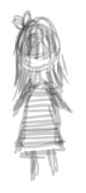
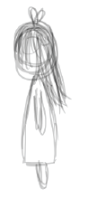
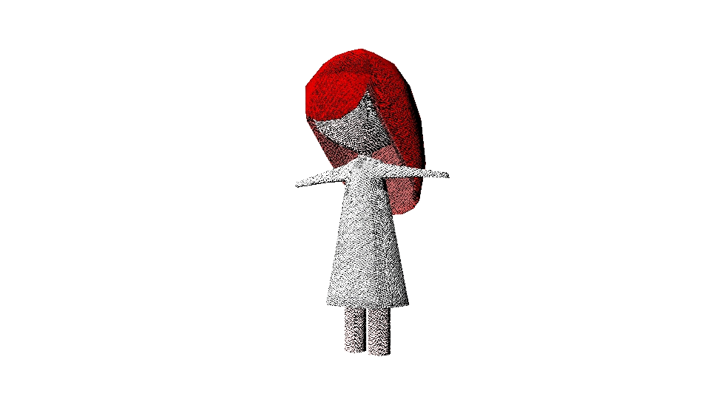
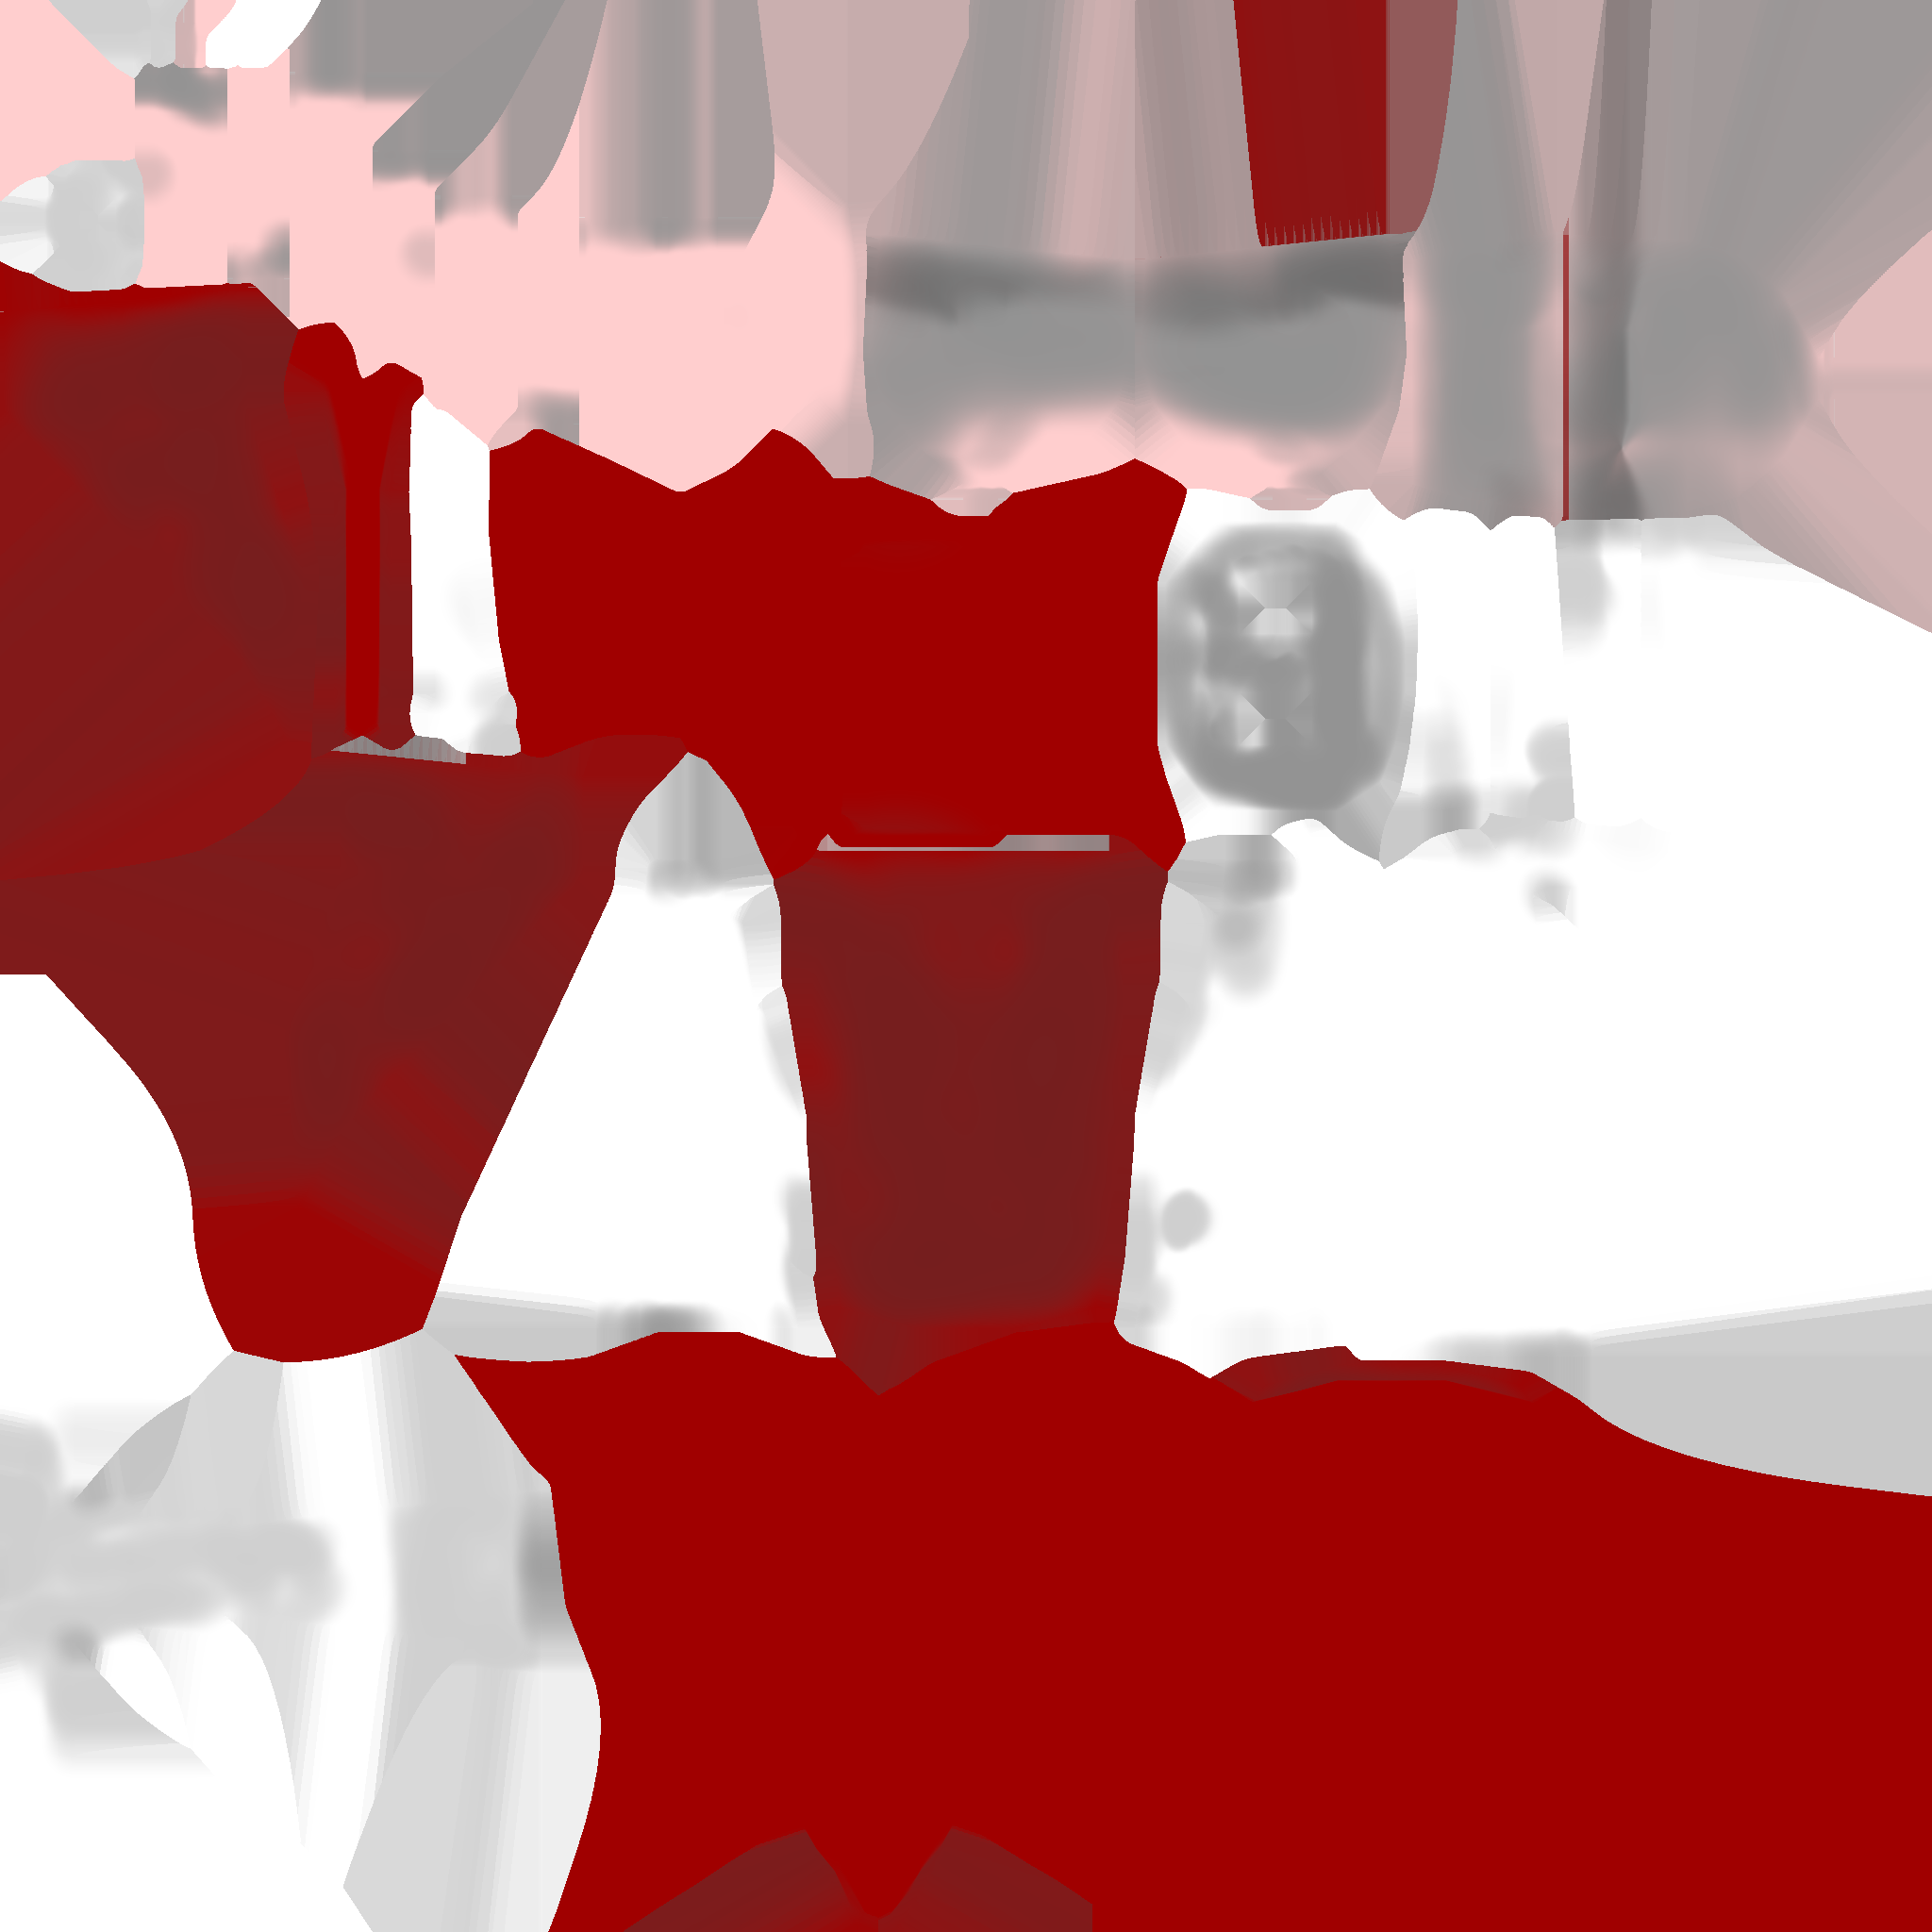
Abigail
7 years old
Prone to nightmares

Slide 4
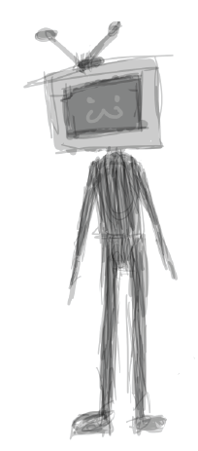
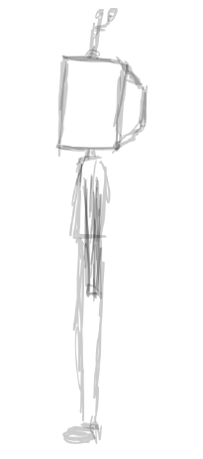


TV Man
Part TV
Part Man

Slide 5
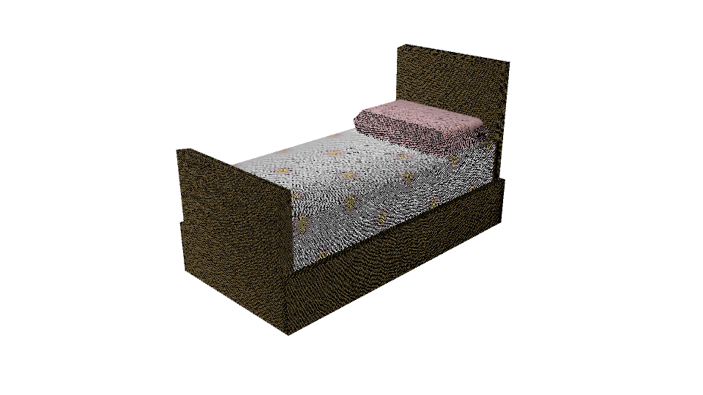

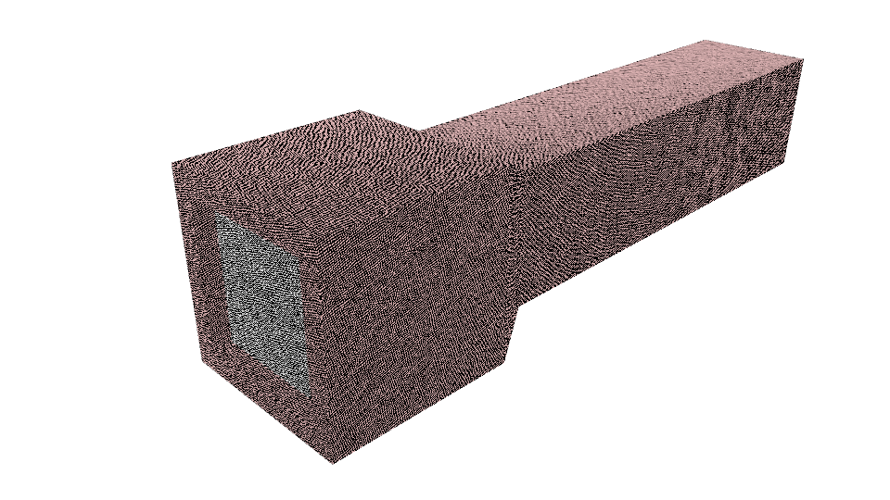
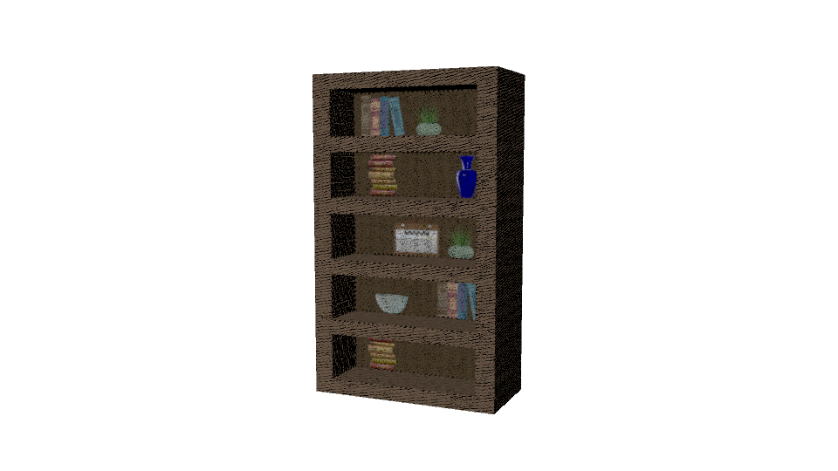
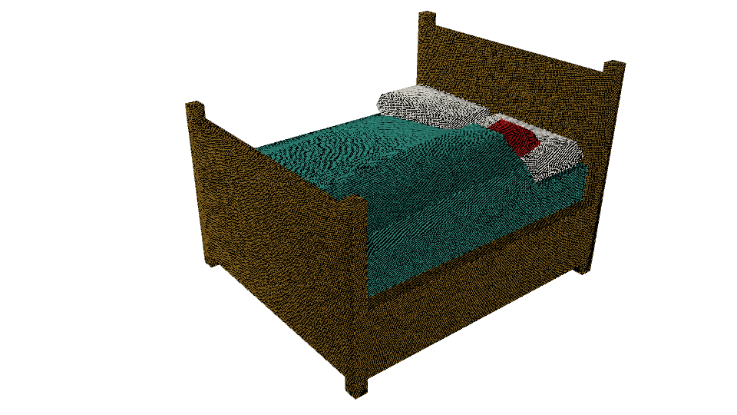
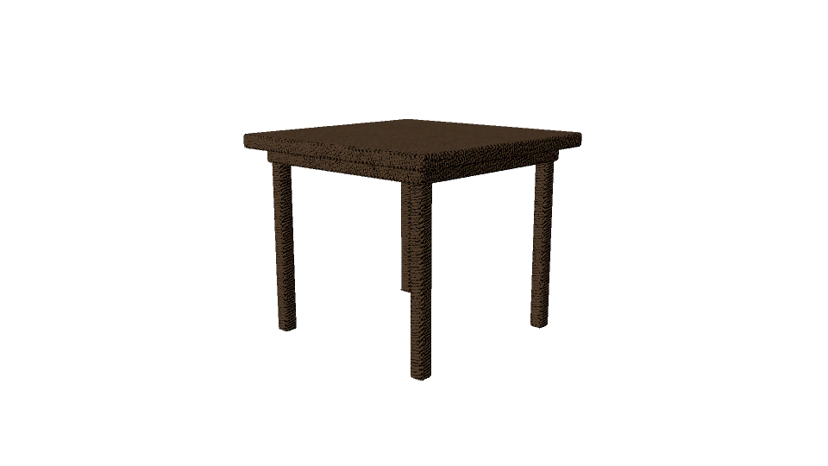
Game Objects
Flashlight
Abigail’s bed
Mom’s bed
Bookcase
Table
Mirror

Slide 6
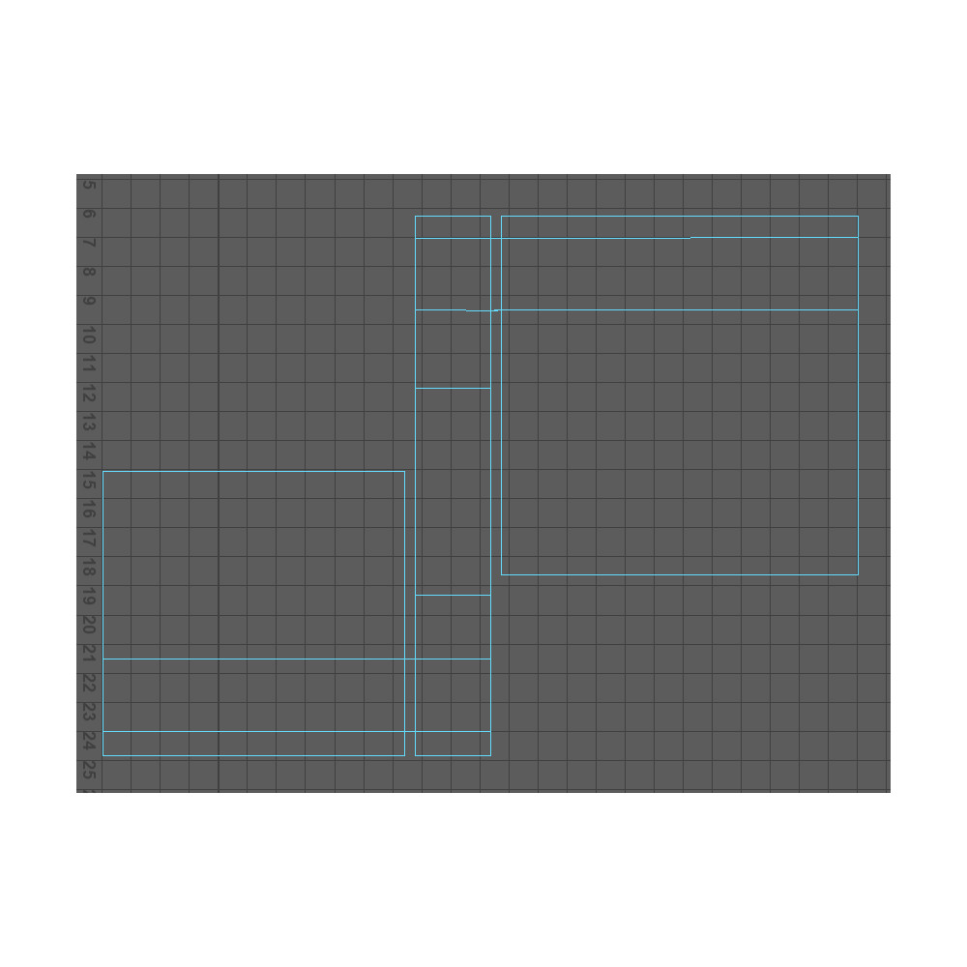
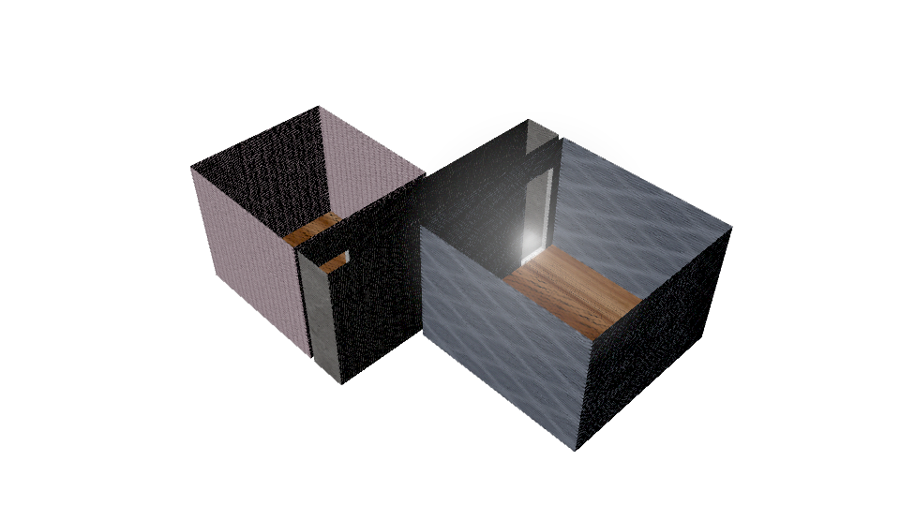
Game Map and Map Build

Slide 7

Title Screen

Slide 8
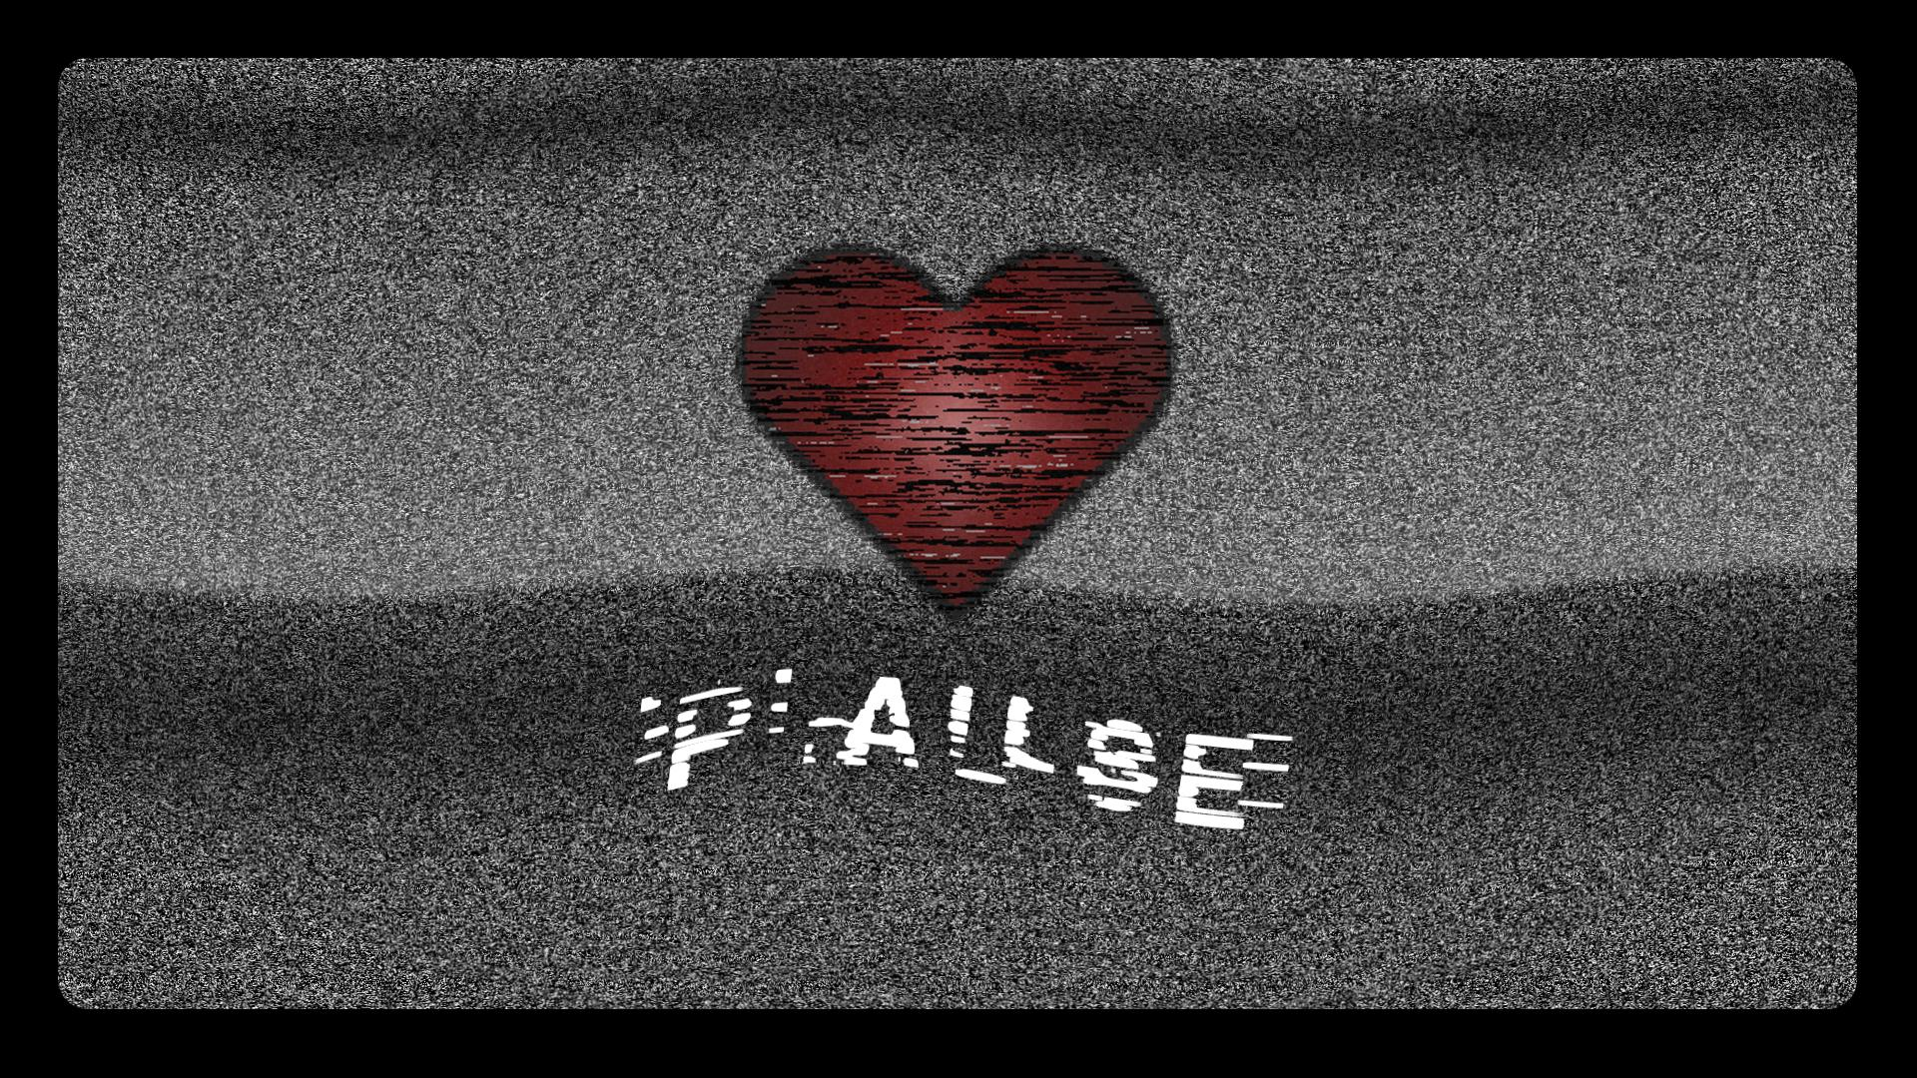
Pause Screen

Slide 9

Game Over

Slide 10

Win Screen

